Slide 1

Equimatics
Team: Giovanni Harvey and Raghav Sethi
University: University of Waterloo
Challenge: Esri App Challenge 2021
Date: February 19, 2021

Slide 2

Mission Statement

Slide 3
Equimatics – Food Desert Solver
“Food deserts” have emerged over the past 20 years as spaces of concern for communities, public health authorities and researchers because of their potential negative impact on dietary quality and subsequent health outcomes.
Food deserts are residential geographic spaces, typically in urban settings, where low-income residents have limited or no access to retail food establishments with sufficient variety at an affordable cost.
Research on food deserts presents methodological challenges including retail food store identification and classification, identification of low-income populations, and transportation and proximity metrics.
Furthermore, the complex methods often used in food desert research can be difficult to reproduce and communicate to key stakeholders.
To address these challenges, we introduce Food Desert Solver. The goal of our web application is to help the government and residents identify food deserts collectively and generate a central optimal location for new grocery store establishments.

Slide 4
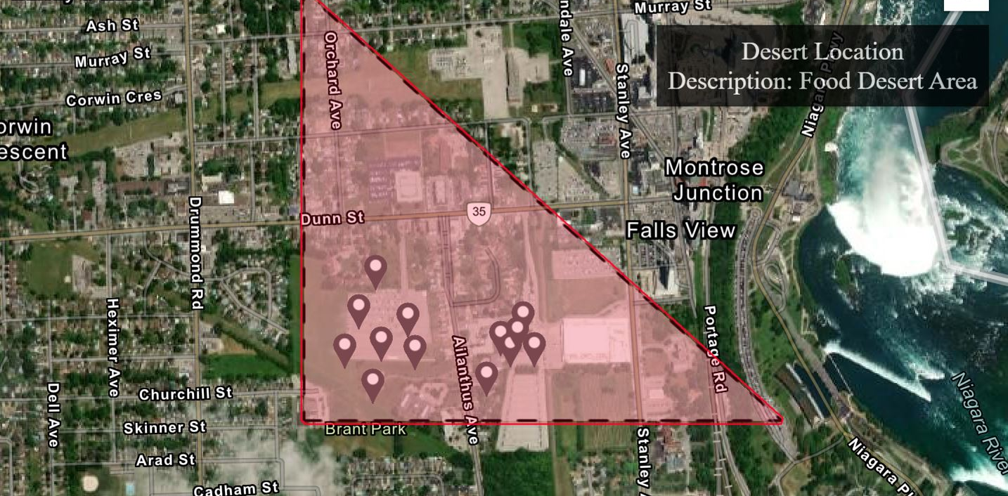
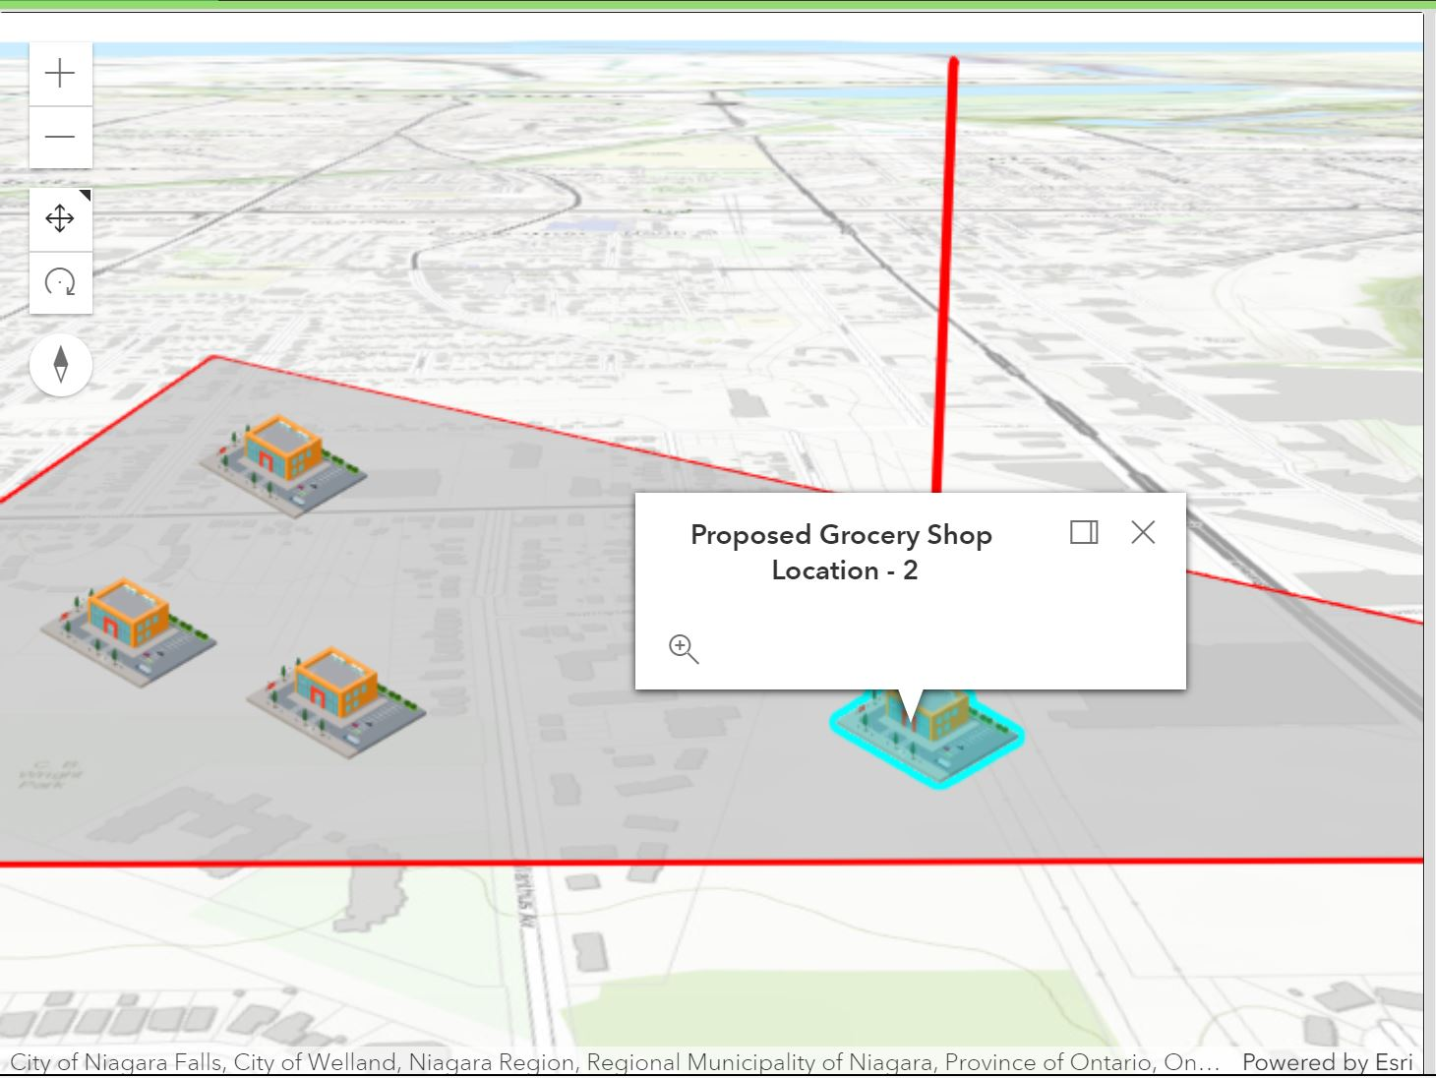
Equimatics – Food Desert Solver

Slide 5

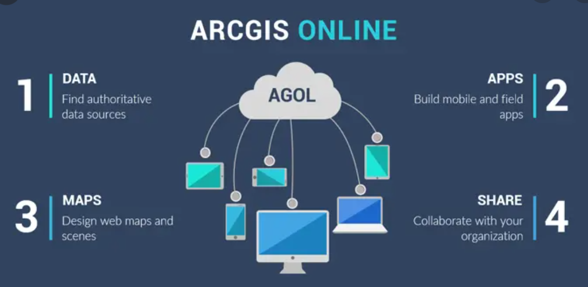


Technologies Used
List of Technologies
ArcGIS JavaScript API 4.18
ArcGIS Online (for layer hosting)
Google’s Firebase (easily accessible and free database and hosting)
Turf Js API (for clustering algorithms)
HTML, CSS and JavaScript

Slide 6
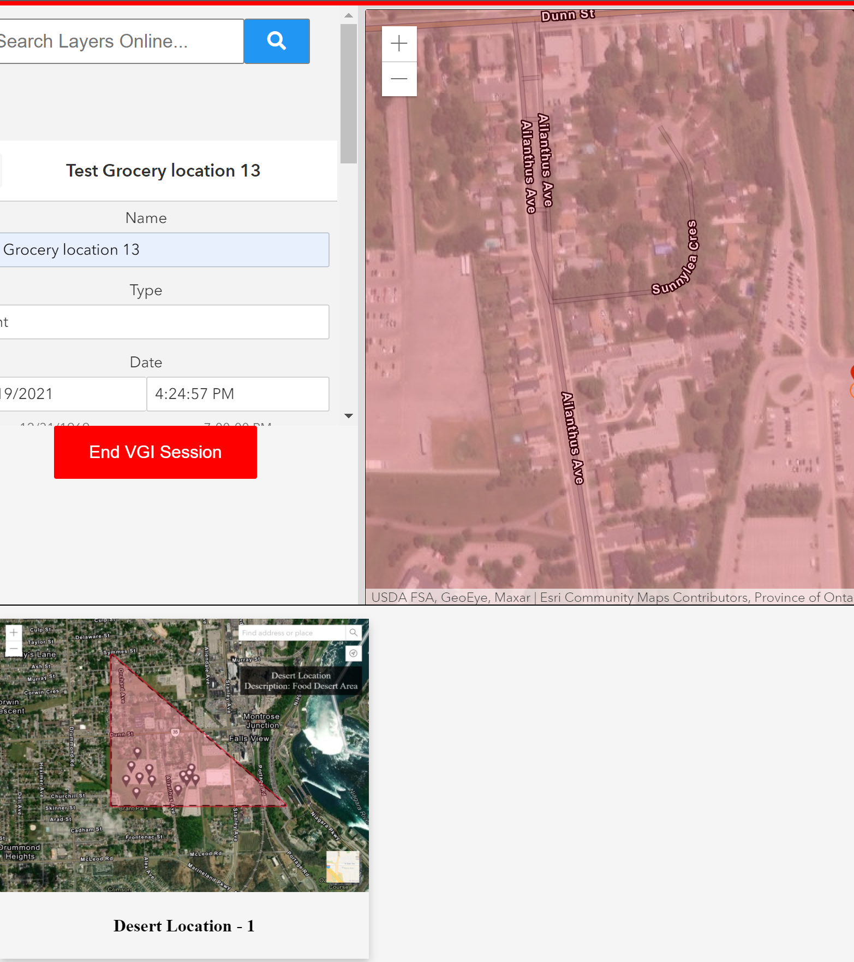
Application Features
Enables collaboration between “residents” and “governments”
Uses a combination of Volunteered Geographic Information (VGI) and Participatory GIS (PGIS) Process to engage residents

Slide 7
Application Features
The VGI and PGIS data can be used by the government to derive clusters and identify central locations
These central locations would be possible locations to build grocery shops to better serve the community.
For e.g. reducing commute time; access better quality fruits, vegetables, meat; better price rates

